Slide 1
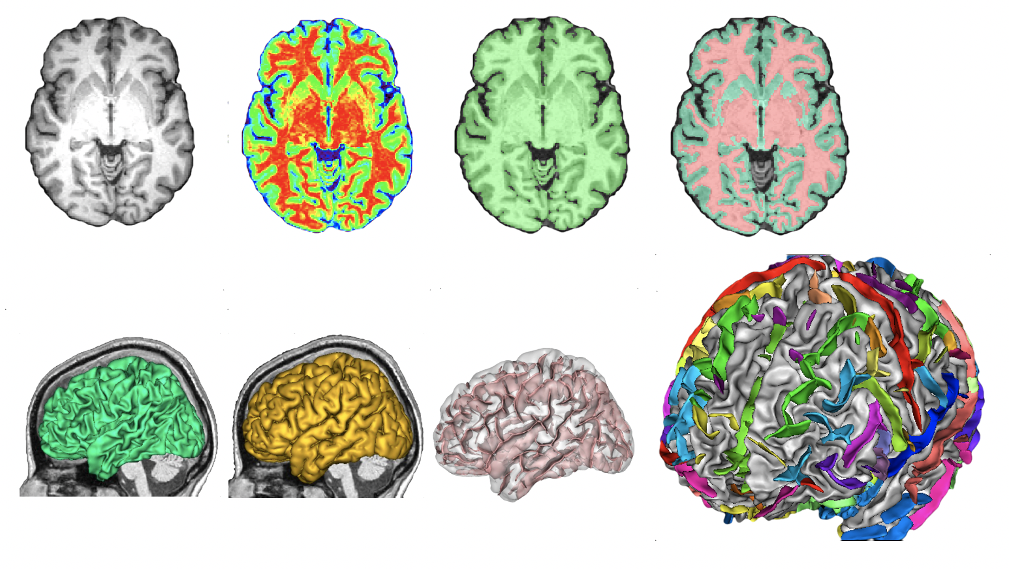
Introduction to Data Science
in R for Neuropathology
Go Ogata, Will Snyder

Slide 2
Goals
Introduce data science in R with an application to neuropathology
Demonstrate the importance of visualizing data before analysis
Model good practices in determining and evaluating results

Slide 3
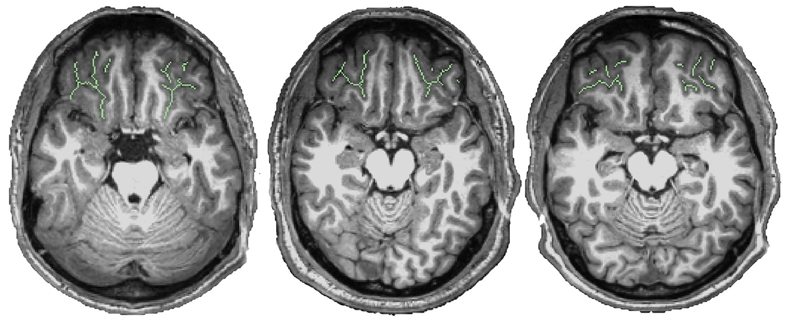
Introduction to the Dataset
Type I Type II Type III

Slide 4
Research Question
Does the gray matter thickness in the Orbitofrontal Cortex of the human brain vary by which pattern type of brain folding that is present?
Ho : Gray matter thickness is the same for pattern types I, II, and III
Ha : At least one pattern type differs in its gray matter thickness

Slide 5
Information to Know
New Packages:
oro.nifti
New File Types:
file.nii

Slide 6
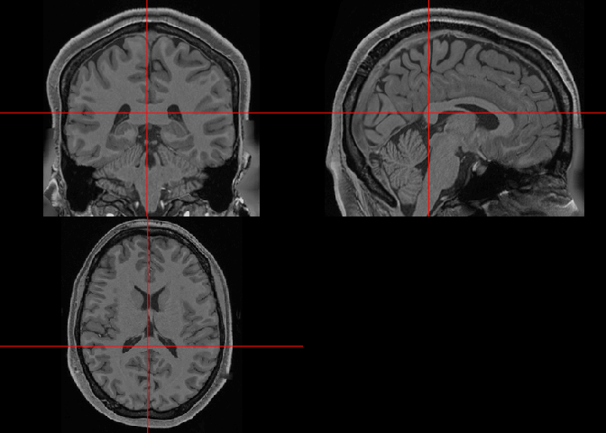
Displaying the Brain Scans
```{r Displaying the Brain Scans}
orthographic(scan)
```

Slide 7
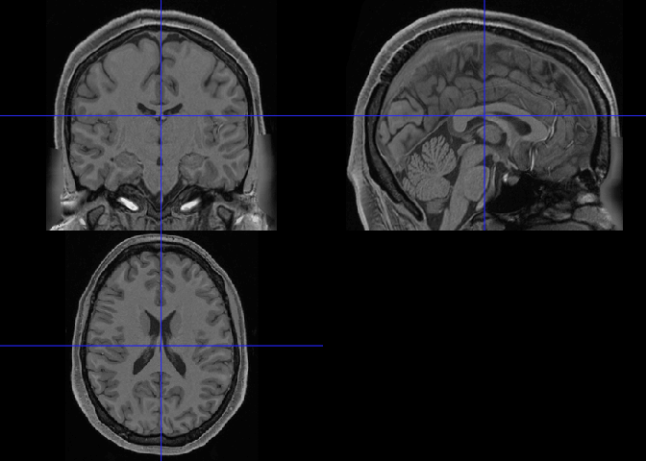
Displaying the Brain Scans with Setting
```{r Displaying the Brain Scans with Settings}
orthographic( scan , xyz = c(125,125,125) ,crosshairs = T, col.crosshairs = "blue")
```

Slide 8
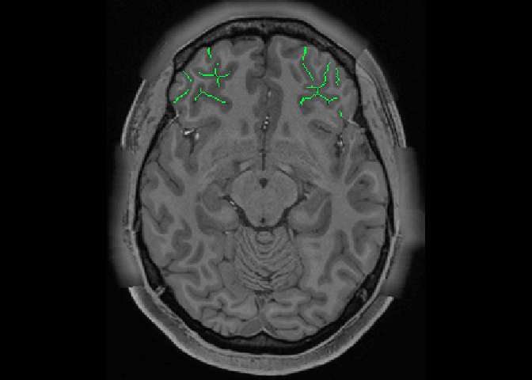
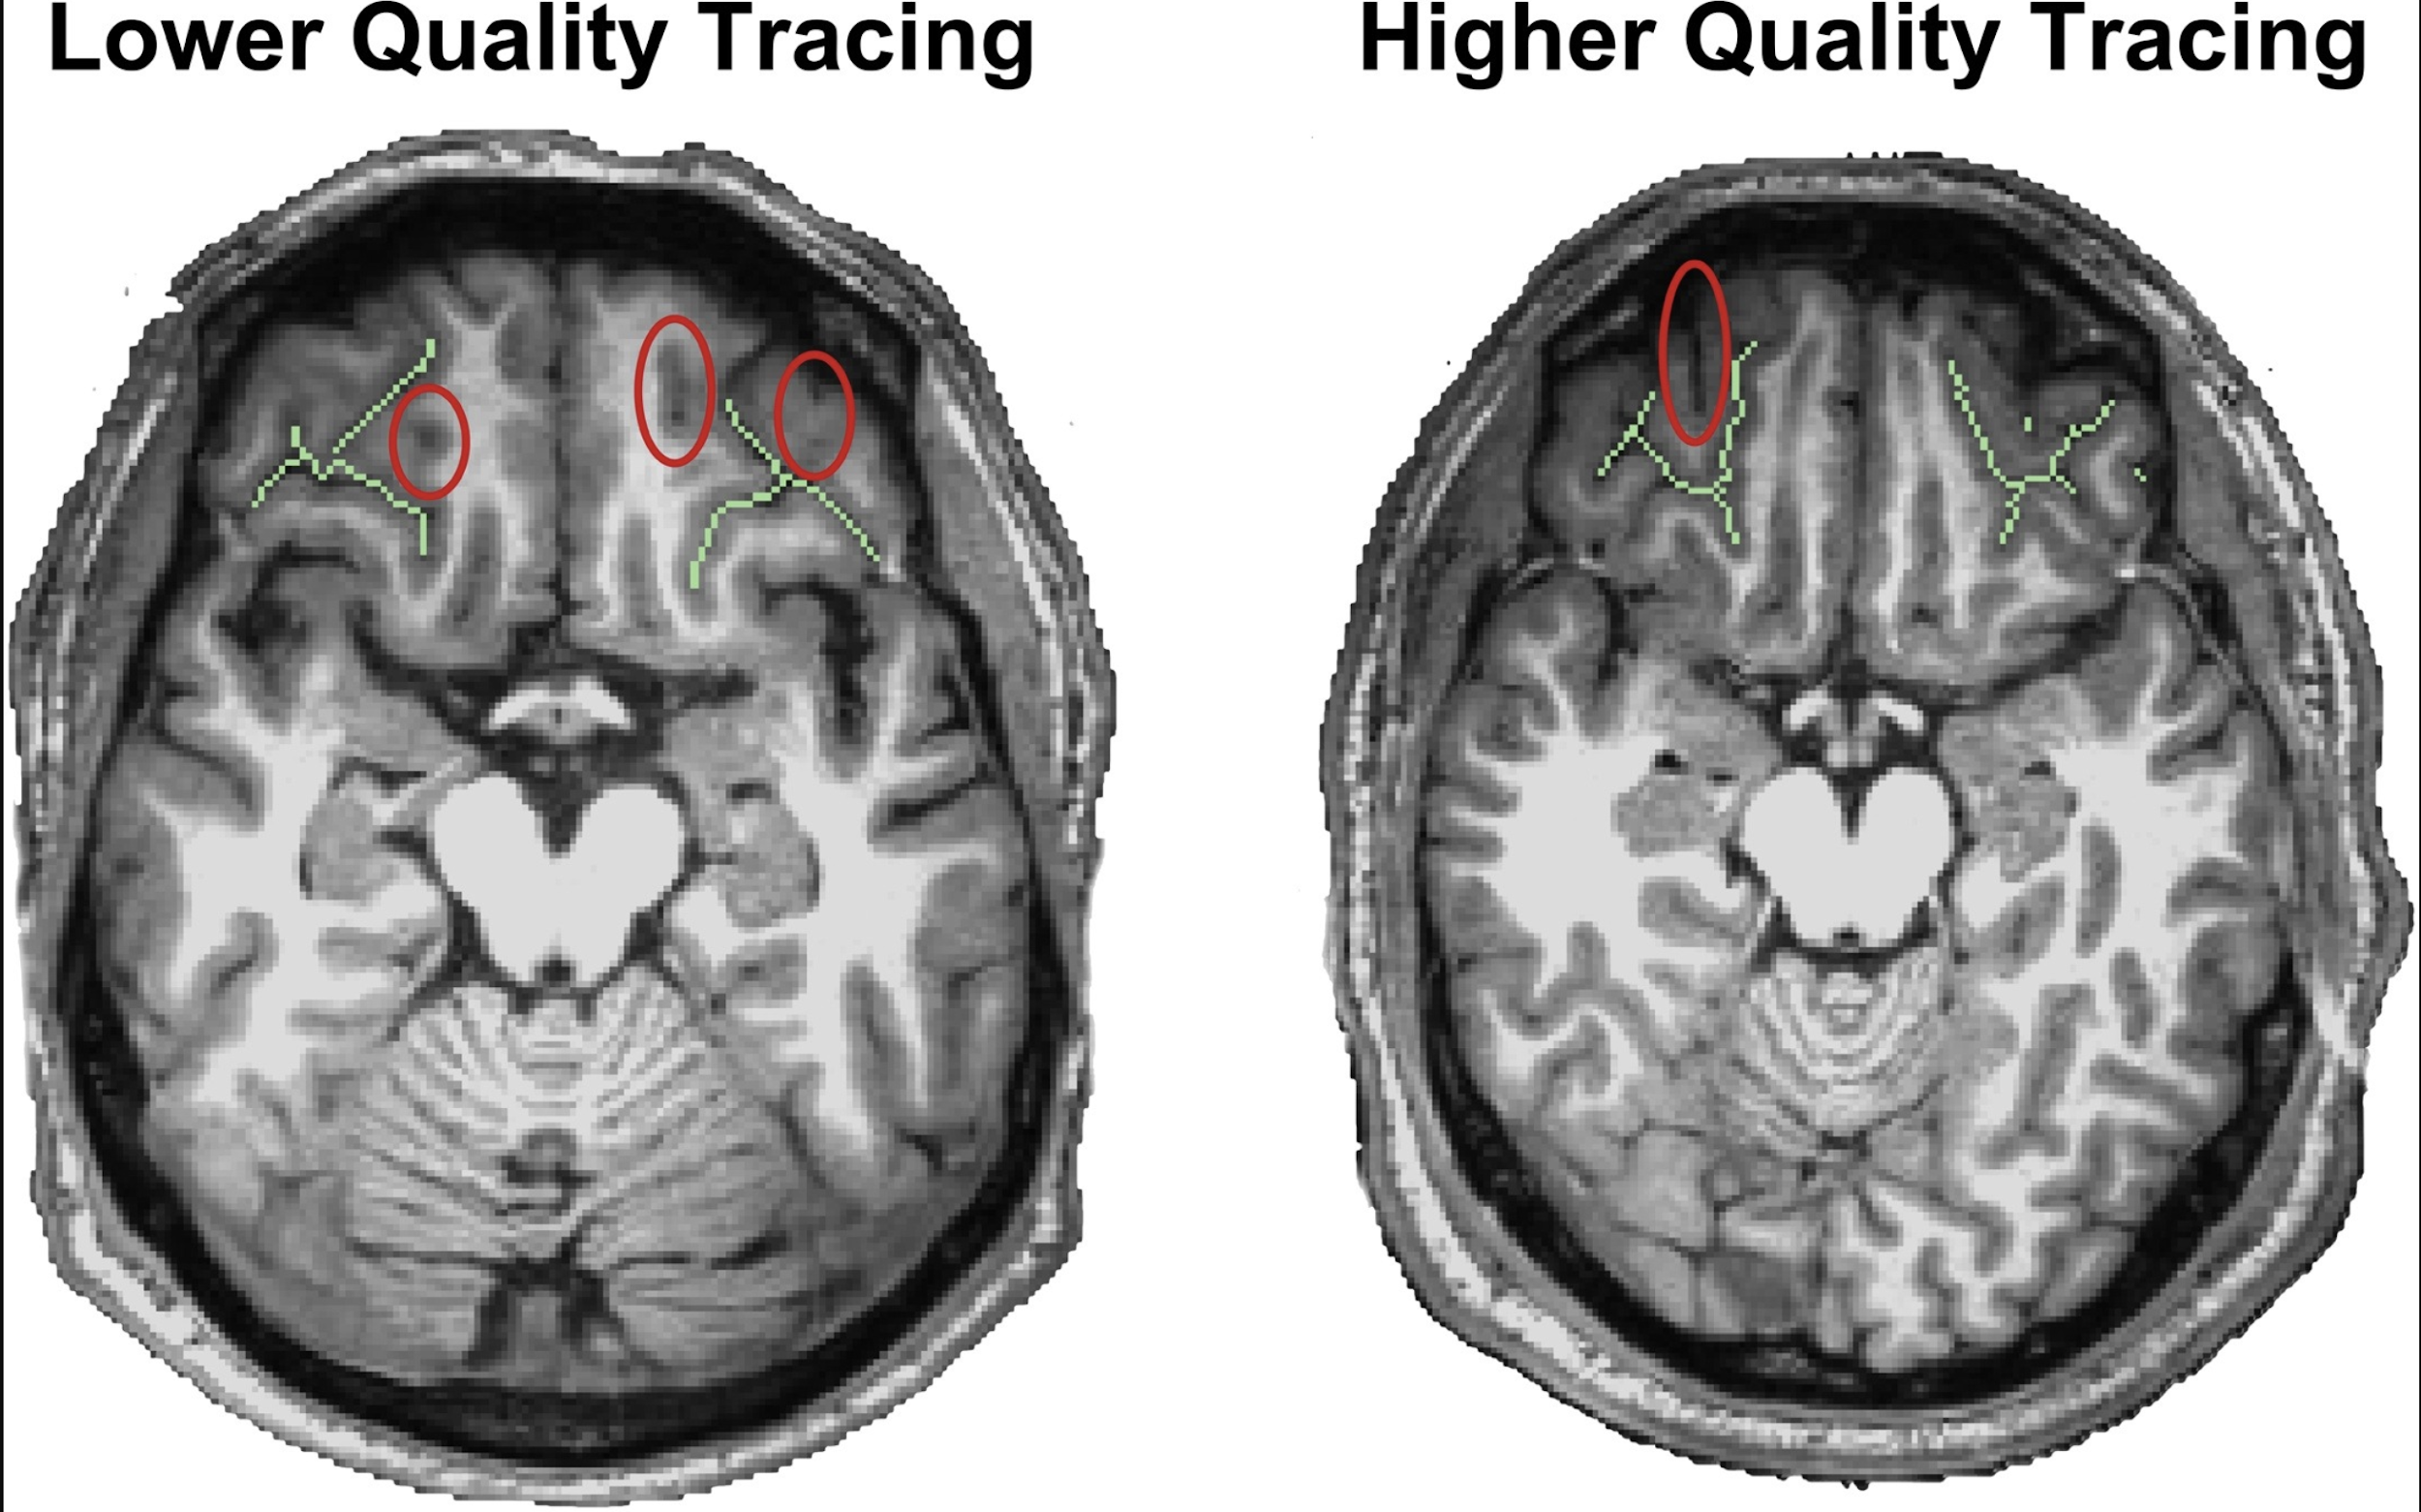
Displaying the Brain Scans with Overlay
```{r Displaying the Brain Scans with Settings}
overlay(x = scan, y = sulci, z = 85, plot.type = "single", col.y = "green")
```

Slide 9
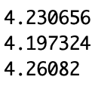
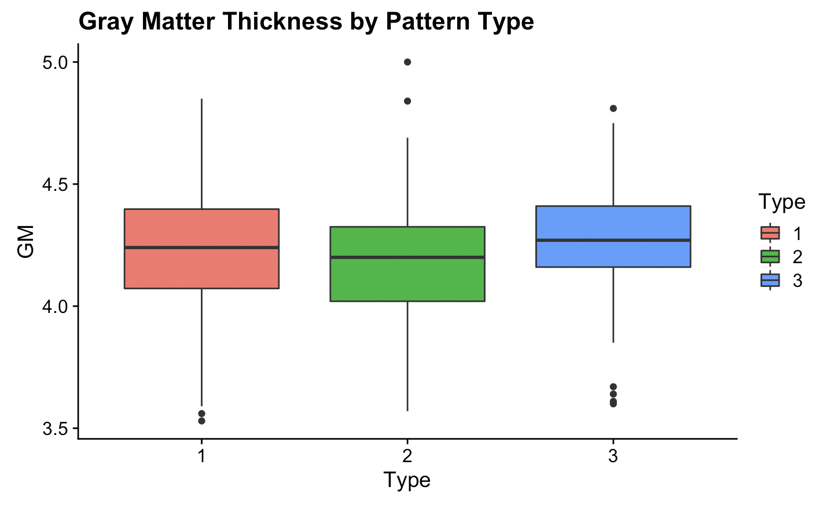
Gray Matter Thickness Across Folding Patterns
```{r comparing means across pattern types}
mean(type_one_gray_matter_vals)
mean(type_two_gray_matter_vals)
mean(type_three_gray_matter_vals)
ggplot(gm_df)
+ geom_boxplot(aes(x = Type, y = GM, fill = Type))
```

Slide 10
Gray Matter Thickness Statistics
Okay, but how do we statistically compare these values? ANOVA can test whether three or more categorical variables have the same value.
Analysis of Variance (ANOVA):
Variables are independent
Variances of variables are similar
Each variable is normally distributed

Slide 11

Analysis of Variance Requirements: Independence
Analysis of Variance (ANOVA):
Variables are independent
Variances of variables are similar
Each variable is normally distributed

Slide 12
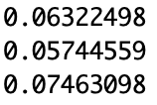
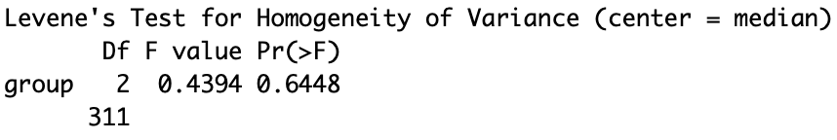
Analysis of Variance Requirements: Variances
Analysis of Variance (ANOVA):
Variables are independent
Variances of variables are similar
Each variable is normally distributed
```{r ANOVA requirements}
var(type_one_gray_matter_vals)
var(type_two_gray_matter_vals)
var(type_three_gray_matter_vals)
leveneTest(GM ~ Type, data = gm_df)
```

Slide 13
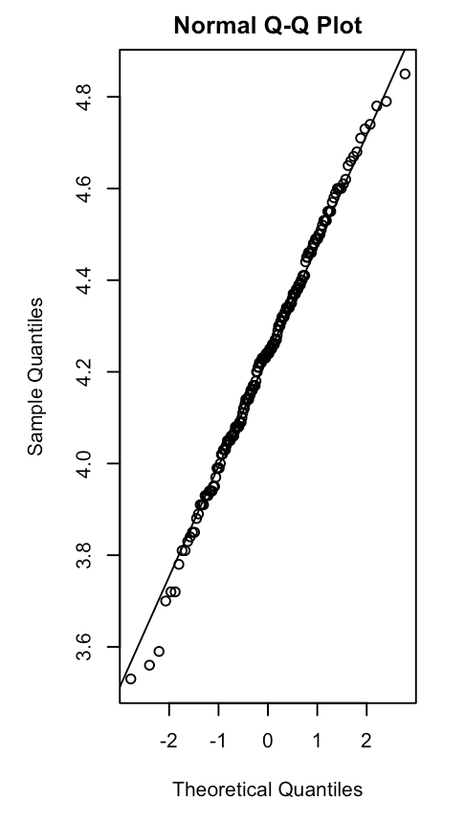
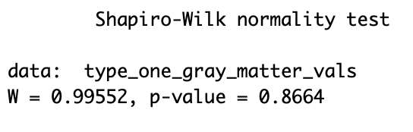
Analysis of Variance Requirements: Normality
Analysis of Variance (ANOVA):
Variables are independent
Variances of variables are similar
Each variable is normally distributed
```{r ANOVA requirements}
simple.eda(type_one_gray_matter_vals)
shapiro.test(type_one_gray_matter_vals)
```

Slide 14
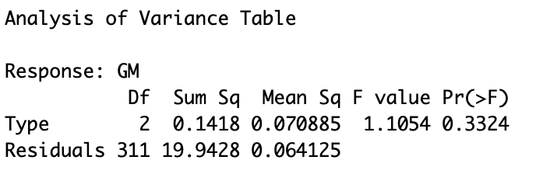
Analysis of Variance
Analysis of Variance (ANOVA):
```{r ANOVA requirements}
fm1 <- aov(GM~Type, data = gm_df)
anova(fm1)
```

Slide 15
Conclusion
It is important to visualize and quality check your data
High p-values can be interesting! (but do not entail direct evidence for Ho)
Data science can be powerful to evaluate patterns in neuropathology-related data

